Slide 1
3T Working Group – January 7th 3T Terminology, Taxonomy, Technology - 3T Overview - Revised Charter Update - Phase II Release and Definition, Taxonomy - Security & Trustworthiness Sub-Group - Platform Stack → Open Source - New Business Maturity Framework Sub-Group Update - Introduction of NTT’s Digital Twin Vision - Liaison and Regional Branch Update

Slide 2
Technology, Terminology & Taxonomy Working Group
Terminology
Security
Trustworthiness
Common Characteristics
Enabling
Technologies
Platform
Stacks
Taxonomy
Types

Slide 3
New DTC 3Ts WG Charter (Proposed):
3Ts Group is a horizontal group, that is meant to collaborate and gather feedback from all groups, subgroups, and tiger teams at the DTC to meet the following objectives:
Define a consistent standard definition for “Digital Twin” across multiple industries
Define what describes a digital twin, why is it used and how it is applied
Create a concentrated multi-party (industry enterprise, non-profit, and academic) effort to harmonize terminology and representations of Digital Twins, and put forward a single authoritative vocabulary
Explore types of digital twins used in the market, and define relationships between them
Applicability of each type of digital twin, and their relationships to existing business applications to maximize the value of digital twins’
Identify technical components -led by Platform Stack Tiger Team- needed to build digital twins to support a wide range of business activities
Identify enabling technologies for Digital Twins, and create a reference architecture
Address the need for industry security and compliance requirements as Digital Twins become more interoperable, and create a model and best practices across industries, guided by the Security and Trustworthiness subgroup
Develop a digital business maturity framework to help businesses achieve measurable outcomes with successful implementation and adoption of Digital Twins
Define levels of business maturity, and organizational areas that affects implementation and adoption of Digital Twins
Provide a roadmap for businesses depending on their maturity level to implement Digital Twins
Guide successful implementations by embedding Digital Twins at the core of business operating model
The 3Ts working group will consolidate vertical WG efforts to publish opinions and position statements, and establish DTC’s authority & thought leadership, definitions, launch of Value Innovation Platforms, identification of gaps in Standards, taxonomy, and reference architectures.
DRAFT

Slide 4
Definition and Phase II Update

Slide 5
Technical Reports: Phased Release Proposal
Phase 1 – Doc Release
Definition / Description
Phase 2 – Doc Release
Stack/Lifecycle
Phase 3 – Doc Release
Use Case/Case Study
Introduction and Scope
Definition Process
What is included
What is Excluded
Vocabulary and Terminology
Definition
Supporting Statements
Elaboration Description
TBD:
Types of Digital Twins
High level view - Taxonomy
Platform Stack
Layered stack diagram
Open Source consideration
External Data provisioning
Lifecycle Phases
Digital Twin View (Virtualized)
Asset / Entity View (OT)
Maturity Model
Framework
Common Characteristics
Enabling Technologies
Blueprint: Reference architecture
Use Cases Examples
High Level - overview
Case Study – advance view
Next Installment
Updates on Use case analysis
Case Study detail
ROI , Business Outcome, Value at Stake
References
Platform 4.0 and IIC DT Admin Shell WP
Digital Twin Whitepapers utilized
…
Notes:
1 week to 2 weeks for iteration

Slide 6
Security and Trustworthiness Sub-Group
Jon Geater and Detlev Richter

Slide 7
Agenda
Standing orders (New Members, Minutes, Liaison Reports)
AOB
Welcome and terms of reference
WELCOME TO 2021!
Priorities for this year
Dynamic Trustworthiness Cases

Slide 8
Priority work items for 2021

Slide 9
Outline for 2021
What are we trying to achieve
A model of Trustworthiness that works in the real, messy world of I4.0
A way of communicating that to business leaders for buy-in: ROI calculator
What are the key concepts that will get us there?
Quantifying and balancing the case for Trustworthiness
Resiliency vs safety & security
Dynamic assurance cases
What do we need to do to develop understanding of those concepts?
Workable definitions of assurance case concepts (vocab → ontology)
Use case worked examples

Slide 10
Sample focus topics
We would like to offer a large part of each meeting to specific Subject Matter Experts for a two-way exchange on how our wider work intersects their specialty:
Maturity Models
Dynamic assurance cases
Data regulations and certification
Safety regulations and certification
Embedded security technologies
Distributed computing and fuzzy processing concepts
Analog security/safety and physical environment sensing
Vertical WG business cases

Slide 11
Draft timeline
Q1: Agree and write up a clear taxonomy/vocabulary for the different major abstractions we’re working with (in concert with new 3T platforms sub group):
The infrastructure on which Digital Twins and Physical Twins run (facilities, computers, storage media etc)
The data/processing layer
The twin itself (as a system composed of the data/processing layer)
Q1: Write up security and safety strategies for these according to today’s static approach
Q1: Publish high level 2-pager guide on how to convert this to dynamic safety/security cases
Q2: Deep-dive on detailed standards/technologies that can help us (with guest specialists):
Digital identity
Trusted Execution
Distributed applications (including but not limited to blockchain type)
ISO/IEC standards (62443 and friends)
Maturity Models
Other (canvas the group. Other good ideas have been floated)
Q3: Create the detailed doc on dynamic trustworthiness assurance cases

Slide 12
Platform Stack Sub-Group
Email: platform-stacks@engage.digitaltwinconsortium.org
^{7th} January 2021

Slide 13
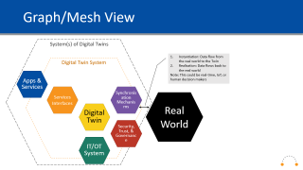

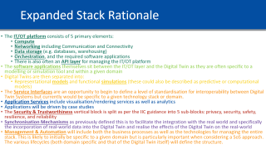
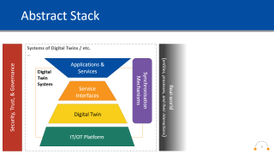
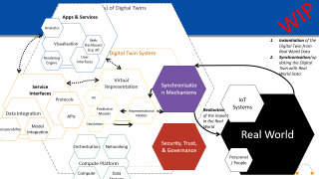
Outline
Abstract Stack
Rationale
Expanded Traditional Stack
Mesh View
Simplified
Expanded
Notes:
to Dan Isaacs - Digital Twin Consortium (privately): 4:03 PM
HI Dan, any particular objectives you'd like to see today? Or carry on as normal?
from Dan Isaacs - Digital Twin Consortium (privately): 4:06 PM
not at this point other than disuss the stack expanded in context of graph/mesh
from Dan Isaacs - Digital Twin Consortium to everyone: 4:24 PM
An API describes all the valid messages that one program can accept. It says nothing about the proper ordering of these messages, or their interaction with other programs.
Protocols sit on top of APIs. A protocol describes the valid sequence of messages that flow between the APIs of multiple parties to accomplish some higher-level task
from Dan Isaacs - Digital Twin Consortium (privately): 4:24 PM
Just put a description from the web on differences
from Dan Isaacs - Digital Twin Consortium (privately): 4:26 PM
so interesting points as i can see the opposite being true also
from Sean Olcott to everyone: 4:37 PM
In definition: A representational model is a digital model consisting of persisted information.
A simulation model is an executable digital model (of a process) consisting of reference data and computational algorithms which (when executed or “run”) take representational models as input and produce representational models as output.
from Sean Olcott to everyone: 4:38 PM
A representational model is a digital model consisting of persisted information.
A simulation model is an executable digital model (of a process) consisting of reference data and computational algorithms which (when executed or “run”) take representational models as input and produce representational models as output.
from Sean Olcott to everyone: 4:54 PM
In current draft of definition: To synchronize (in the context of a digital twin) means to cause the virtual representation to more-closely match the real-world or cause the real-world to more-closely match the virtual representation of a desired state.
Real-to-virtual synchronization is the process of mirroring the real world in the virtual representation.
Virtual-to-real synchronization is a process of mirroring the virtual representation into the real world.
A real-to-virtual synchronization mechanism is a means by which the virtual representation is synchronized with the real-world as a result of observations made of the real-world.
A virtual-to-real synchronization mechanism is a means by which the real world is changed to match an intended state depicted in the virtual representation.
Synchronization frequency is the frequency with which synchronization occurs.
Synchronizing fidelity is a characterization of the degree of detail and accuracy of the digital twin.
from Chafia Aouissi to everyone: 4:54 PM
I've to drop. Thank you everyone. Great discussions.

Slide 14
Abstract Stack
Security, Trust, & Governance
Systems of Digital Twins / etc.
…
Real-world
(entities, processes, and their interactions)
Applications &
Services
Synchronisation Mechanisms
Digital
Twin
System
Service Interfaces
Digital Twin
IT/OT Platform

Slide 15
Abstract Stack Rationale
A Digital Twin System is comprised of Digital Twins, the IT/OT system they run on and the required APIs and protocols for integration and use within other systems and applications. This in turn facilitates the creation of Systems of Systems (shown as Systems of Digital Twins) approach to integrating Digital Twins for meaningful use cases. The practical approach to describing these concepts is primarily in terms of federations of Digital Twin Systems where both the larger System of Systems and the individual DT are valid DTs. The Digital Twin System may not always include the Applications & Services when implemented within a SoS solution.
Data is also all around the system but not explicitly shown within the stack diagram but is pulled out in the mesh view to indicate the flow of data between different parts of the system.
Horizontally (bottom up)
As per the definition all Digital Twins must run/exist on an IT/OT Platform of some form. This provides the base layer for computation, connectivity, data storage etc. This can mostly be considered as enabling technologies as suggested by Gartner’s Digital Twin reference model
Digital Twins then run on/use that IT/OT platform, this includes all types of twins and the appropriate breakdown of their parts. Specifically this includes digital models (reference and simulation) and their supporting data
Above the Digital Twins are the “standardised” service interfaces (i.e. integrations, APIs, and protocols) for use within particular domains or with other Twins.
An API describes all the valid messages that one program can accept. It says nothing about the proper ordering of these messages, or their interaction with other programs. Protocols sit on top of APIs. A protocol describes the valid sequence of messages that flow between the APIs of multiple parties to accomplish some higher-level task. Services interfaces summarise these concepts.
At the top of the abstract stack are the applications, services and systems that either feed into, work with, or make use of the twins
Vertically (left-right)
The aspects of privacy, security, trust, safety, and governance should be considered at all layers of the architecture including the physical world which provides the context for everything else
Synchronisation Mechanisms are a central tenet of Digital Twins and is also defined as a vertical concept from a perspective of ingress, egress, and interoperability. This is indicated between the physical world and the software world’s as it is also the means for synchronising data between the Digital Twin and the real world. These can occur at any layer but would make use of the IT/OT platform. Note: the synchronisation mechanisms is primarily referring to the synchronisation with the real world and not the interactions within the system itself. It is envisaged that synchronisation could however occur between 2 or more Digital Twin Systems as part of large SoS approach (this would likely be similar to the concepts of co-simulation).
The Physical world or real world exists both as the context in which a digital twin operates (and so is the context for the IT/OT platforms) but stretches across the stack and as it is connected to the Digital Twin. It must be noted that scope of this architecture does NOT include IoT systems, physical security considerations, etc.

Slide 16
Expanded Stack
Systems of Digital Twins / etc.
…
Security, Trust, & Governance
Real World
Privacy
Applications
& Services
Applications
Synchronisation Mechanisms
Digital
Twin
System
Visualisation / Render Services
Analytics
Services
Security
Service Interfaces
Service Interfaces
Digital Twin
Digital Twin Interaction/Integration Functions
Management & Automation
Safety
Computational Simulation Models
Digital Representational Models
Resilience
IT/OT Platform
Software Platform / Tooling Stack
Platform APIs
Reliability
Orchestration
Compute
Networking
Data Storage

Slide 17
Expanded Stack Rationale
The IT/OT platform consists of 5 primary elements:
Compute
Networking including Communication and Connectivity
Data storage (e.g. databases, warehousing)
Orchestration, and the required software applications
There is also often an API layer for managing the IT/OT platform
The software applications themselves sit between the IT/OT layer and the Digital Twin as they are often specific to a modelling or simulation tool and within a given domain
Digital Twins are then separated into:
Representational models and functional simulations (these could also be described as predictive or computational models)
Digital Twin Interaction/Integration Functions provide a framework to combine various types of digital twins in an integrated digital world and an unified layer to expose Service Interfaces
The Service Interfaces are an opportunity to begin to define a level of standardisation for interoperability between Digital Twin Systems but currently would be specific to a given technology stack or domain.
Application Services include visualisation/rendering services as well as analytics
Applications will be driven by case studies
The Security & Trustworthiness vertical block is split as per the IIC guidance into 5 sub-blocks: privacy, security, safety, resilience, and reliability
Synchronisation Mechanisms as previously defined this is to facilitate the integration with the real world and specifically the incorporation of real-world data into the Digital Twin and realise the effects of the Digital Twin on the real-world
Management & Automation will include both the business processes as well as the technologies for managing the entire stack. This is likely to initially be specific to a given domain but is particularly important when considering a SoS approach. The various lifecycles (both domain specific and that of the Digital Twin itself) will define the structure.
Notes:
Note: I’ve not included the concept of “assurance” as it should be encapsulated by the other 5

Slide 18
Mesh Perspective
Service Interfaces
Applications & Services
Data Integration
Protocols
Rendering
Analytics
Model / Simulation Interoperability
Model Integration
User Interfaces
Visualisation
Synchronisation Mechanisms
Security, Trust, & Governance
Management & Automation
Real → Virtual
Virtual → Real
Digital Twin
IT / OT Platform
Integration Functions
Interaction Functions
Orchestration
Platform APIs
Software Platform / Tooling Stack
Digital Representations
Computational Simulation
Compute
Networking
Data Storage

Slide 19
Expand Platform Stack to 3T Sub-Group Include Focus on Open Source
A Digital Twin workflow (from engineering model to embedded code)
The key technologies required to build a multi-physics, equation-based, twin
(Modelica, Julia, Ansys Simulation, etc.)
The key technologies for integrating equation-based twin with the information twin
(MSFT Twin Builder, DTDL, DDS, etc.)
The key technologies needed to interface the equation-based twin with automation and control systems (IEC 61131, IEC61499, IEC 61508 etc.)
The pathway to develop Opensource modeling languages and reference models that allow us to:
Build Multiphysics models for systems of systems
Interface automation & control systems with the models
Interface the equation and information models
Export engineering quality control code from the model
Export embeddable code from the model that can be used at the edge
Co-simulate models from different vendors
(e.g. an FEA or CFD model run in-the-loop with an automation model)

Slide 20
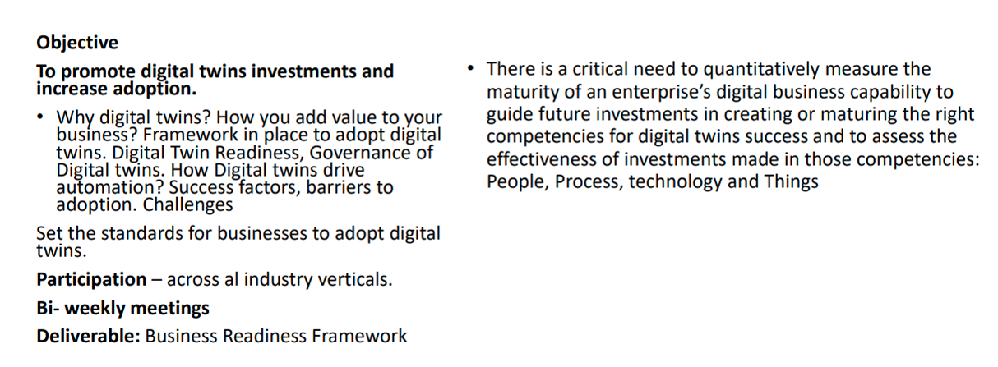
New Business Maturity Framework Sub-Group

Slide 21
Introduction of NTT’s Digital Twin Vision
^{7th} January 2021

Slide 22
> Consortium Expansion - Liaison Status - Regional Branch Update

Slide 23
Growth: Liaisons & Regional Teams

Slide 24


Liaisons – Collaborations In Progress
IIC - Signed
Building Smart- Signed
CABA – Continental Building Association - Signed
CDBB – Center for Digitally Built Britain - In progress
CPC - Construction Progress Congress – In progress
SCCANZ – Smart City Council for Australia and New Zealand – In progress
In Progress:
SWAN – Smart Water Association
FIWARE -
GMG - Global Mining Group
OSMG – Open Source Modelica Group
IDTA – Discussions in progress

Slide 25
Strategic Objectives of Digital Twin Consortium Regional Teams
The purpose of a Regional Team is to facilitate local Digital Twin Consortium activities that can sometimes be hindered by language, culture and time zones, and to take advantage of access to local officials and official documents.
Regional teams and their meeting are open to all Digital Twin Consortium members and will be held at the convenience of regional members in terms of language, culture and time zones.

Slide 26

Regional Team Expansion - In Progress
Africa
Australia
Canada
Germany
India
Italy
Japan
Korea
North America
South America
Italy:
Manufacturing
Chile:
Sustainable Foods
Water Management
Nigeria, Ghana:
Transportation & Energy

